Slide 1
Data Link Control (DLC)
AI42/AD42 Data Communication and Networking

Slide 2
Framing
Framing in the data-link layer separates a message from one source to a destination by adding a sender address and a destination address
The destination address defines where the packet is to go
The sender address helps the recipient acknowledge the receipt
Why the whole message not packed in one frame?
A frame can be very large, making flow and error control very inefficient
When a message is carried in one very large frame, even a single-bit error would require the retransmission of the whole frame
When a message is divided into smaller frames, a single-bit error affects only that small frame
Frame Size?
Fixed-Size Framing
Variable-Size Framing

Slide 3
Framing …
Fixed-Size Framing
no need for defining the boundaries of the frames
the size itself can be used as a delimiter
An example of this type of framing is the ATM WAN, which uses frames of fixed size called cells
ATM: Asynchronous Transfer Mode( connection oriented, high-speed network technology that is used in both LAN and WAN over optical fiber and operates upto gigabit speed )
Variable-Size Framing -
need a way to define the end of one frame and the beginning of the next
Historically, two approaches were used for this purpose:
a character-oriented (or byte-oriented) approach
a bit-oriented approach
prevalent in local-area networks

Slide 4
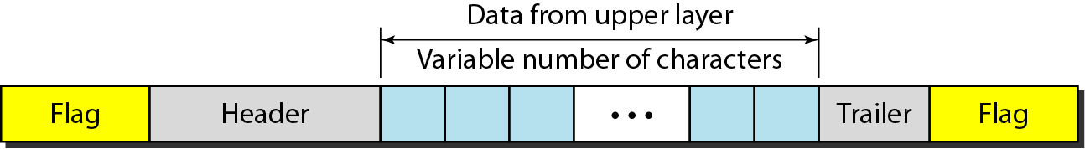
Character-Oriented Framing
Data to be carried are 8-bit characters from a coding system such as ASCII
The header (also multiples of 8 bits) normally carries
the source and destination addresses
other control information
the trailer, which carries error detection redundant bits
To separate one frame from the next, an 8-bit (1-byte) flag is added at the beginning and the end of a frame
The flag composed of protocol-dependent special characters

Slide 5
Problem with flag
Text communication: flag could be selected to be any character not used for text communication
Sending other types of information such as graphs, audio, and video: any character used for the flag could also be part of the information
If flag is a part of the information, the receiver, when it encounters this pattern in the middle of the data, thinks it has reached the end of the frame

Slide 6
Solution to Flag Problem
Add a byte-stuffing strategy to character-oriented framing
In byte stuffing (or character stuffing), a special byte is added to the data section of the frame when there is a character with the same pattern as the flag
The data section is stuffed with an extra byte
called the escape character (ESC) and has a predefined bit pattern
Whenever the receiver encounters the ESC character, it removes it from the data section and treats the next character as data, not as a delimiting flag
If the escape character is part of the text, an extra one is added to show that the second one is part of the text

Slide 7
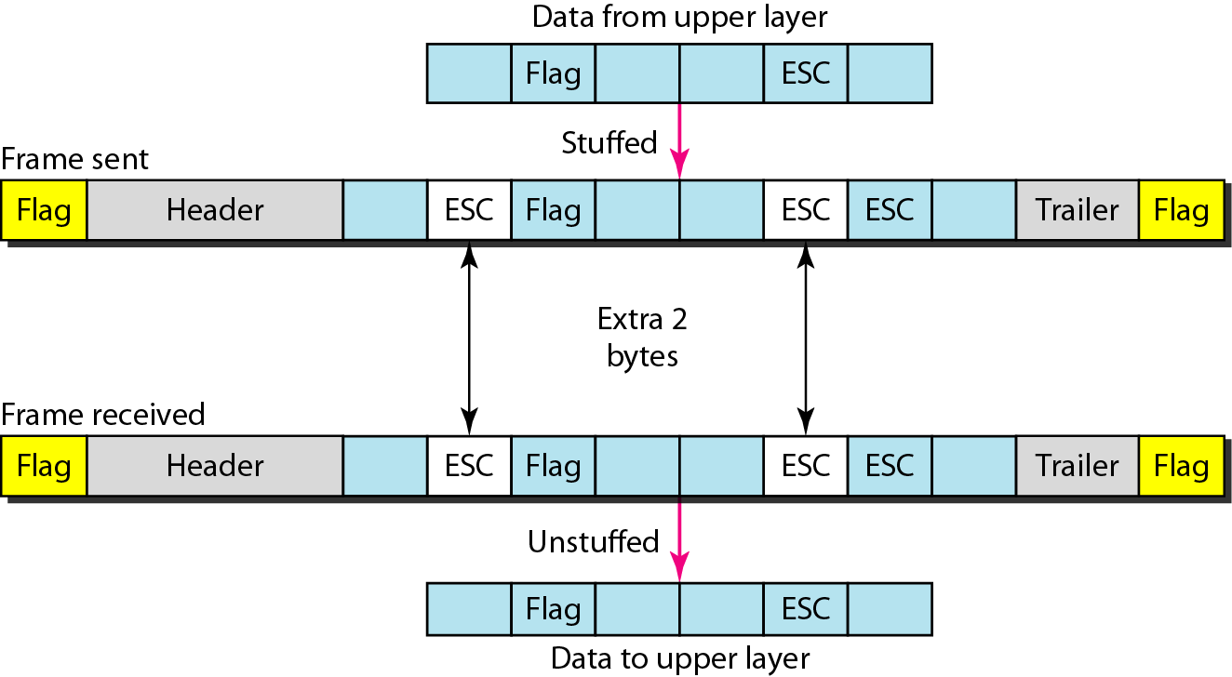
Byte stuffing and unstuffing
The universal coding systems in use today, such as Unicode, have 16-bit and 32-bit characters that conflict with 8-bit characters
bit-oriented protocols

Slide 8
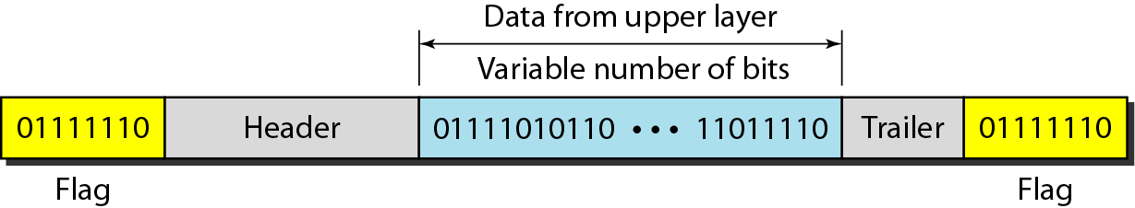
Bit-Oriented Framing
Data section of a frame is a sequence of bits to be interpreted by the upper layer as text, graphic, audio, video, and so on
In addition to headers (and possible trailers), need a delimiter to separate one frame from the other
Most protocols use a special 8-bit pattern flag, 01111110, as the delimiter to define the beginning and the end of the frame

Slide 9
Bit-Oriented Framing
Bit stuffing is the process of adding one extra 0 whenever five consecutive 1s follow a 0 in the data, so that the receiver does not mistake the pattern 0111110 for a flag
If the flaglike pattern 01111110 appears in the data, it will change to 011111010 (stuffed) and is not mistaken for a flag by the receiver
The real flag 01111110 is not stuffed by the sender and is recognized by the receiver

Slide 10
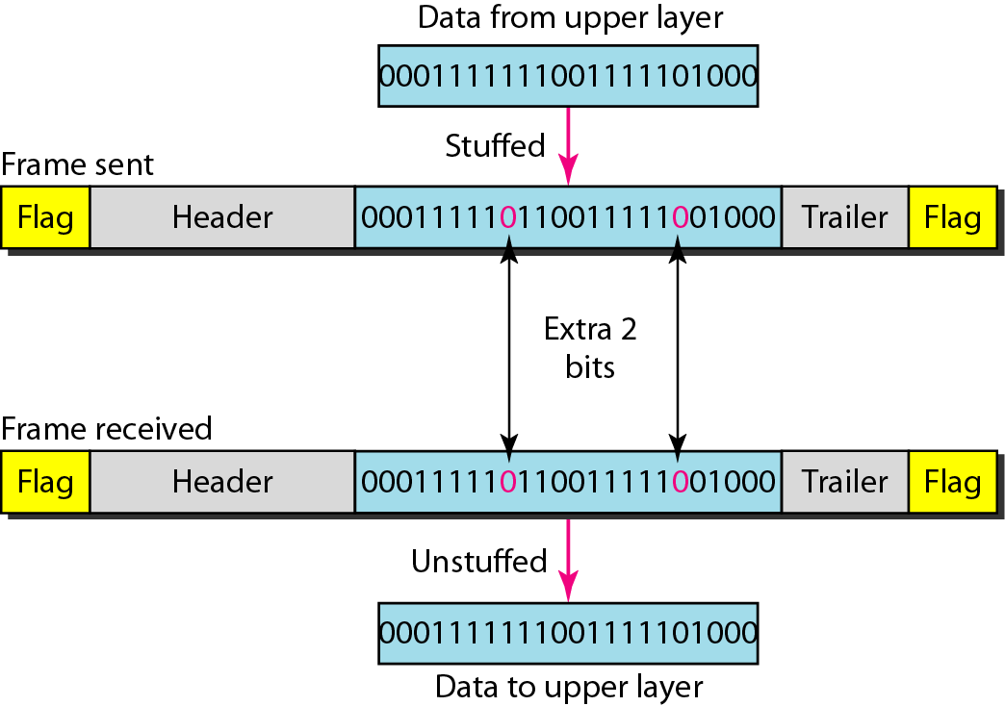
Bit-Oriented Framing

Slide 11
Example 1
Byte-stuff the following frame payload in which
E is the escape byte
F is the flag byte
D is a data byte
other than an escape or a flag character.
F D E E D D E F D D E E E E D E F D F

Slide 12
Example 2
Unstuff the following frame payload in which
E is the escape byte
F is the flag byte
D is a data byte
other than an escape or a flag character.
E D F D D F E D D D

Slide 13
Example 3
Bit-stuff the following frame payload:
0001111111001111101000111111111110000111
00011111011001111100100011111011111010000111

Slide 14
Example 4
Unstuff the following frame payload:
00011111000001111101110100111011111000001111
00011111000001111101110100111011111000001111
00011111000011111111010011101111100001111

Slide 15
Error Control
At the data-link layer, corrupted frame needs to be corrected before it continues its journey to other nodes
Detecting errors
block coding
cyclic codes – CRC
checksums
Correcting errors
Forward error correction
Hamming distance
XORing of packets
interleaving chunks
compounding high and low resolutions packets
Automatic repeat request (ARQ)
Most link-layer protocols simply discard the frame and let the upper-layer protocols handle the retransmission of the frame

Slide 16
Error Detection and Correction Issues
Types of Errors
Single-bit and burst error
Redundancy
some extra bits with our data
Detection versus Correction
Coding
block coding and convolution coding

Slide 17
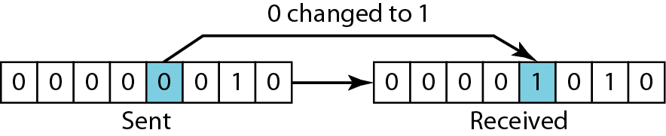
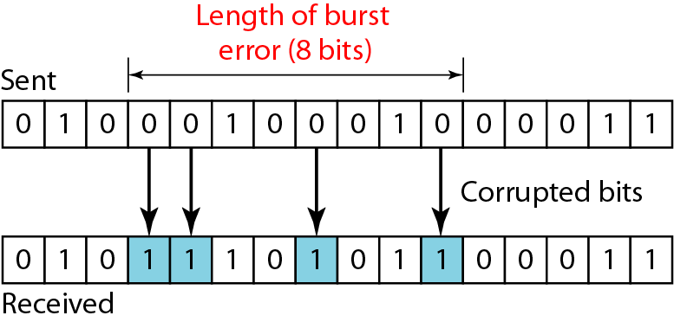
Types of Errors
Single-bit errors: only 1 bit of a given data unit is changed from 1 to 0 or from 0 to 1
Burst errors: 2 or more bits in the data unit is changed from 1 to 0 or from 0 to 1
more likely to occur because the duration of the noise signal is normally longer than the duration of 1 bit
The number of bits affected depends on the data rate and duration of noise
Consider a noise of 1/100 second, 1 kbps data rate can affect 10 bits whereas 1 Mbps data rate affect 10,000 bits
Notes:
Whenever bits flow from one point to another, they are subject to unpredictable changes because of interference. This interference can change the shape of the signal.
The term single-bit error means that only 1 bit of a given data unit (such as a byte, character, or packet) is changed from 1 to 0 or from 0 to 1. The term burst error means that 2 or more bits in the data unit have changed from 1 to 0 or from 0 to 1. Figure 10.1
shows the effect of a single-bit and a burst error on a data unit.
A burst error is more likely to occur than a single-bit error because the duration of the noise signal is normally longer than the duration of 1 bit, which means that when noise affects data, it affects a set of bits. The number of bits affected depends on the data rate and duration of noise. For example, if we are sending data at 1 kbps, a noise of 1/100 second can affect 10 bits; if we are sending data at 1 Mbps, the same noise can affect 10,000 bits.

Slide 18
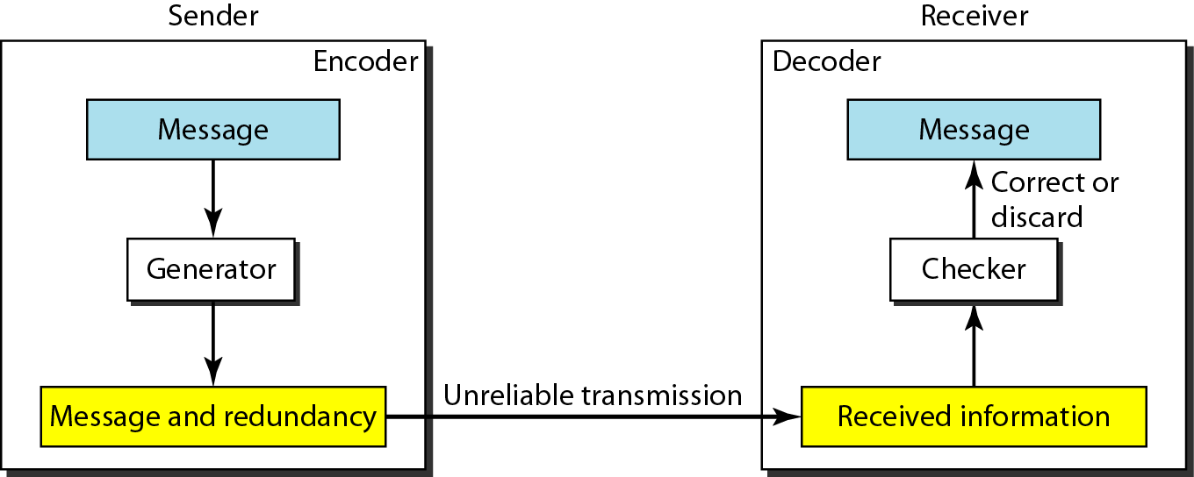
Redundancy
To detect or correct errors, redundant bits (some extra bits) of data must be added by sender and removed by receiver
allows the receiver to detect or correct corrupted bits
Notes:
To be able to detect or correct errors, we need to send some extra bits with our data. These redundant
bits are added by the sender and removed by the receiver. Their presence allows the receiver to detect or correct corrupted bits.

Slide 19
Coding
Process of adding redundancy for error detection or correction creates a relationship between the redundant bits and the actual data bits
Two types:
Block codes
Divides the data to be sent into a set of blocks
Extra information attached to each block
Memoryless
Convolutional codes
Treats data as a series of bits, and computes a code over a continuous series
The code computed for a set of bits depends on the current and previous input
Notes:
Redundancy is achieved through various coding schemes. The sender adds redundant bits through a. The receiver checks the relationships between the two sets of bits to detect errors. The ratio of redundant bits to data bits and the robustness of the process are important factors in any coding scheme.
We can divide coding schemes into two broad categories: block coding and convolution coding. In this book, we concentrate on block coding; convolution coding is more complex and beyond the scope of this book.

Slide 20
Detection versus Correction
correction of errors is more difficult than the detection
error detection → only looking to see if any error has occurred not the number of corrupted bits
No difference between a single-bit error and a burst error
error correction→ need to know the exact number of bits that are corrupted with their location in the message
8-bit data unit
to correct a single error → need to consider eight possible error locations
to correct two errors → need to consider 28 (permutation of 8 by 2) possible error locations
Receiver find difficulty to correct 10 errors in a data unit of 1000 bits
Notes:
The. In. The answer is a simple yes or no. We are not even interested in the number of corrupted bits. A single-bit error is the same for us as a
burst error. In
and, more importantly,. The number of errors and the size of the message are important factors. If we need in an 8-bit
data unit, we; if we need to correct two errors in a data unit of the same size, we need to consider 28 (permutation of 8 by 2) possibilities. You can imagine the receiver’s difficulty in finding 10 errors in a data unit of 1000 bits.

Slide 21
Notes
An error-detecting/correcting code can detect/correct only the types of errors for which it is designed
Other types of errors may remain undetected.
There is no way to detect/correct every possible error!

Slide 22
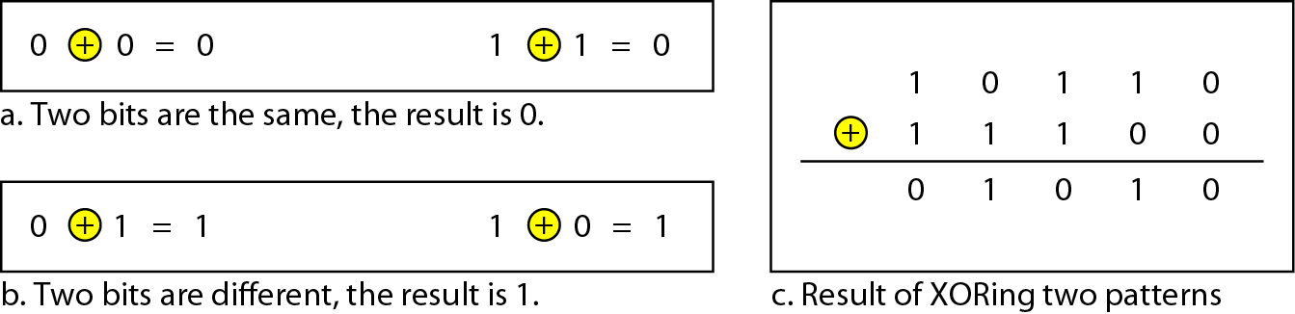
XOR Operation
Main operation for computing error detection/correction codes
Simpler and faster than addition; no carry bit!
Similar to modulo-2 addition

Slide 23
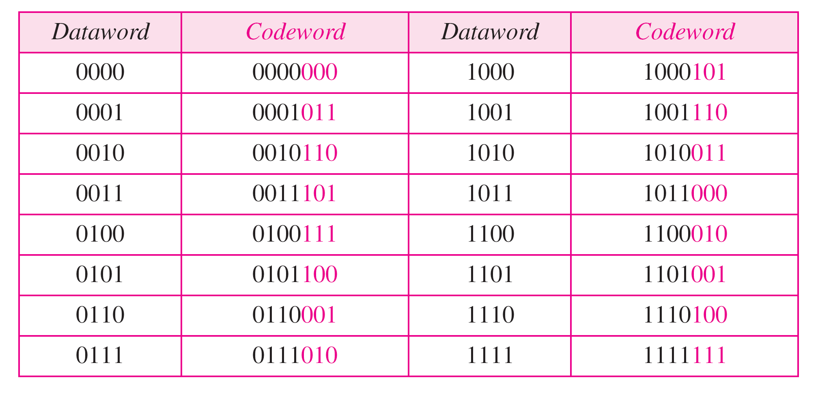
Cyclic Redundancy Check (CRC)
A subset of cyclic codes
Has both the linear and cyclic properties
Used in networks such as LANs and WANs
A CRC code with C(7, 4)

Slide 24
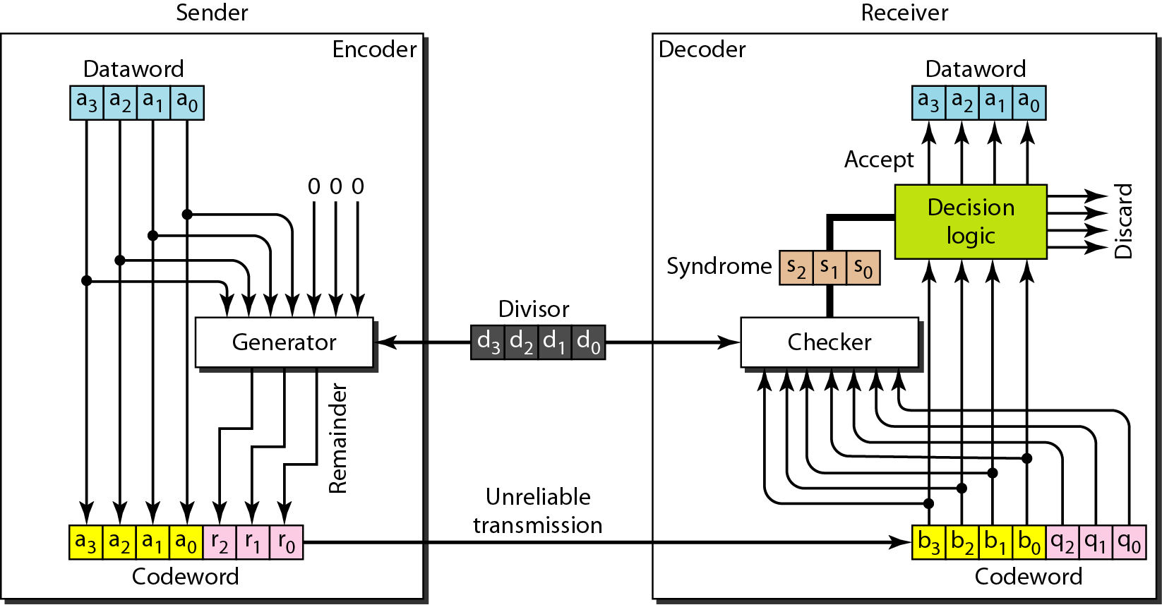
CRC Encoder/Decoder
If the syndrome bits are all 0s, the 4 leftmost bits of the codeword are accepted as the dataword (interpreted as no error); otherwise, the 4 bits are discarded (error).
One possible design:
k bits (4 here)
Added n − k (3 here) 0s to the right-hand side
(modulo-2 division)
divisor of size n − k + 1 (4 here), predefined and agreed upon
remainder produced by checker
Quotient is discarded; remainder (r2r1r0) is appended to dataword to create codeword
copy of all n bits is fed to the checker
n bits (7 here)
Notes:
In the encoder, the dataword has k bits (4 here); the codeword has n bits (7 here). The size of the dataword is augmented by adding n − k (3 here) 0s to the right-hand side of the word. The n-bit result is fed into the generator. The generator uses a divisor of size n − k + 1 (4 here), predefined and agreed upon. The generator divides the augmented dataword by the divisor (modulo-2 division). The quotient of the division is discarded; the remainder (r2r1r0) is appended to the dataword to create the codeword.
The decoder receives the codeword (possibly corrupted in transition). A copy of all n bits is fed to the checker, which is a replica of the generator. The remainder produced by the checker is a syndrome of n − k (3 here) bits, which is fed to the decision logic analyzer. The analyzer has a simple function. If the syndrome bits are all 0s, the 4 leftmost bits of the codeword are accepted as the dataword (interpreted as no error); otherwise, the 4 bits are discarded (error).

Slide 25
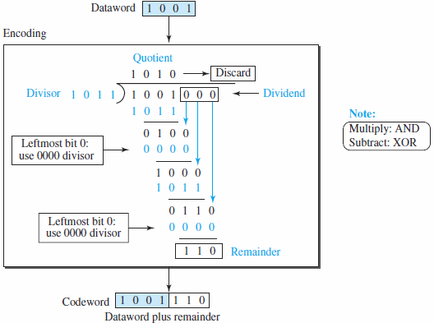
CRC Generator
Division in CRC encoder:
Modulo-2 binary division
Addition and subtraction are the same → use XOR operation to do both
Each step: a copy of the divisor is XORed with the 4 bits of the dividend
Result (remainder) is 3 bits (in this case), which is used for the next step after 1 extra bit is pulled down to make it 4 bits long
Note: If the leftmost bit of the dividend (or the part used in each step) is 0, the step cannot use the regular divisor; we need to use an all-0s divisor
When there are no bits left to pull down, we have a result
3-bit remainder forms the check bits (r2, r1, and r0). They are appended to the dataword to create the codeword
How the divisor 1011 is chosen?
Depends on the expectation we have from the code- we will discuss this in polynomials.
Notes:
The process of modulo-2 binary division is the same as the familiar division process we use for decimal numbers. However, addition and subtraction in this case are the same; we use the XOR operation to do both. As in decimal division, the process is done step by step. In each step, a copy of the divisor is XORed with the 4 bits of the dividend. The result of the XOR operation (remainder) is 3 bits (in this case), which is used for the next step after 1 extra bit is pulled down to make it 4 bits long. There is one important point we need to remember in this type of division. If the leftmost bit of the dividend (or the part used in each step) is 0, the step cannot use the regular divisor; we need to use an all-0s divisor.
When there are no bits left to pull down, we have a result. The 3-bit remainder forms the check bits (r2, r1, and r0). They are appended to the dataword to create the codeword.
Divisor: We may be wondering how the divisor 1011 is chosen. This depends on the expectation we have from the code. We will show some standard divisors later in the chapter (Table 10.4) after we discuss polynomials.

Slide 26
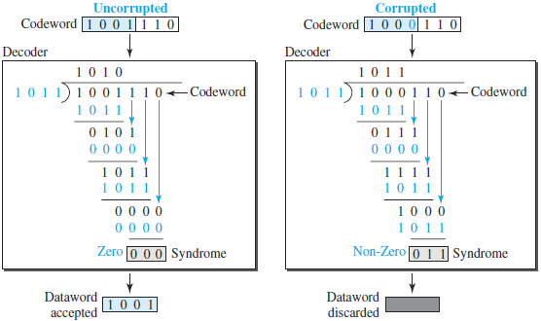
Checking CRC
Division in the CRC decoder for two cases: division process as the encoder
no error
a single error
Remainder of the division is the syndrome
Notes:
The codeword can change during transmission. The decoder does the same division process as the encoder. The remainder of the division is the syndrome. If the syndrome is all 0s, there is no error with a high probability; the dataword is separated from the received codeword and accepted. Otherwise, everything is discarded. Figure 10.7 shows two cases: The left-hand figure shows the value of the syndrome when no error has occurred; the syndrome is 000. The right-hand part of the figure shows the case in which there is a single error. The syndrome is not all 0s (it is 011).

Slide 27
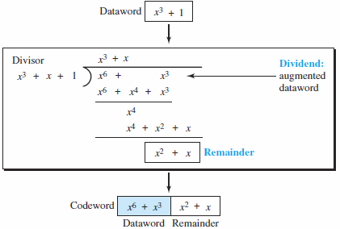
Cyclic Code Encoder Using Polynomials
Creation of a codeword from a dataword
Binary Division in CRC encoder | CRC division using polynomials
Process is shorter
Dataword 1001 is represented as x³ + 1
Divisor 1011 is represented as x³ + x + 1
Augmented dataword is x⁶ + x³ → we have left-shifted the dataword 3 bits (multiplying by x³⁾
Continue to divide until the degree of the remainder is less than the degree of the divisor
In a polynomial representation, the divisor is normally referred to as the generator polynomial
The divisor in a cyclic code is normally called the generator polynomial or simply the generator
Notes:
The result is x6 + x3. Division is straightforward. We divide the first term of the dividend, x6, by the first term of the divisor, x3. The first term
of the quotient is then x6/x3, or x3. Then we multiply x3 by the divisor and subtract (according to our previous definition of subtraction) the result from the dividend. The result is x4, with a degree greater than the divisor’s degree; we continue to divide until the degree of the remainder is less than the degree of the divisor.
It can be seen that the polynomial representation can easily simplify the operation of division in this case, because the two steps involving all-0s divisors are not needed here. (Of course, one could argue that the all-0s divisor step can also be eliminated in binary division.) In a polynomial representation, the divisor is normally referred to as the generator polynomial t(x).

Slide 28
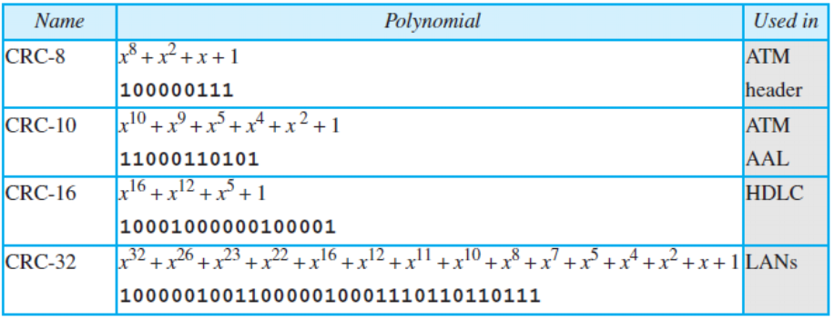
Standard CRC Polynomials
Some standard polynomials used by popular protocols for CRC generation along with the corresponding bit pattern

Slide 29
Advantages of Cyclic Codes
A very good performance in detecting single-bit errors, double errors, an odd number of errors, and burst errors.
Easily implemented in hardware and software
Fast when implemented in hardware
This has made cyclic codes a good candidate for many networks
Other Cyclic Codes
Simple cyclic codes (discussed till now) - the check bits and syndromes can be calculated by simple algebra
Reed- Solomon code - More powerful polynomials that are based on abstract algebra involving Galois fields
used today for both detection and correction
Notes:
Simple cyclic codes (discussed till now) - the check bits and syndromes can be calculated by simple algebra
Reed- Solomon code - More powerful polynomials that are based on abstract algebra involving Galois fields
used today for both detection and correction

Slide 30
Multiple Access Control (MAC)
Problem: When two or more nodes transmit at the same time, their frames will collide and the link bandwidth is wasted during collision
how to determine who gets to use the channel when there is competition for it ?
How to coordinate the access of multiple sending/receiving nodes to the shared link???
Solution: We need a protocol to coordinate the transmission of the active nodes
These protocols are called Medium or Multiple Access Control (MAC) Protocols belong to a sublayer of the data link layer called MAC (Medium Access Control)
What is expected from Multiple Access Protocols:
Main task is to minimize collisions in order to utilize the bandwidth by:
Determining when a station can use the link (medium)
what a station should do when the link is busy
what the station should do when it is involved in collision

Slide 31
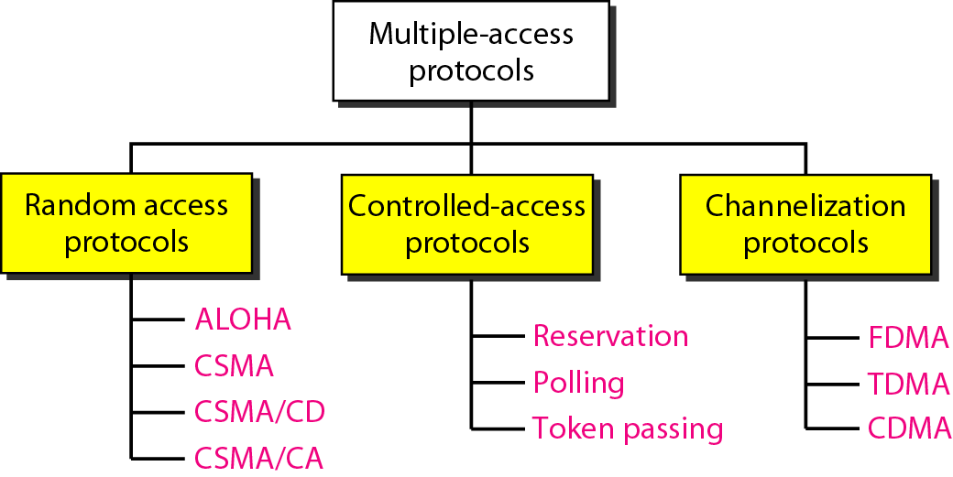
Taxonomy of multiple-access protocols
For wireless

Slide 32
Random Access
Random Access (or contention) Protocols:
No station is superior to another station and none is assigned the control over another
A station with a frame to be transmitted can use the link directly based on a procedure defined by the protocol to make a decision on whether or not to send.
Two features
No scheduled time for a station to transmit - Random Transmission
No rules specify which station should send next
Stations compete with one another to access the medium - contention methods

Slide 33
Evolution of random-access methods
ALOHA -used a very simple procedure called multiple access (MA)
Pure ALOHA - each station sends a frame whenever it has a frame to send
Slotted ALOHA - divide the time into slots and force the station to send only at the beginning of the time slot
Carrier sense multiple access (CSMA) - improved ALOHA
forces the station to sense the medium before transmitting
Two parallel evolved methods
carrier sense multiple access with collision detection (CSMA/CD)
tells the station what to do when a collision is detected
carrier sense multiple access with collision avoidance (CSMA/CA)
tries to avoid the collision

Slide 34
Carrier sense multiple access with collision detection (CSMA/CD)
The CSMA method does not specify the procedure following a collision
CSMA/CD augments the algorithm to handle the collision
A station monitors the medium after it sends a frame to see if the transmission was successful
If so, the station is finished
If there is a collision, the frame is sent again

Slide 35
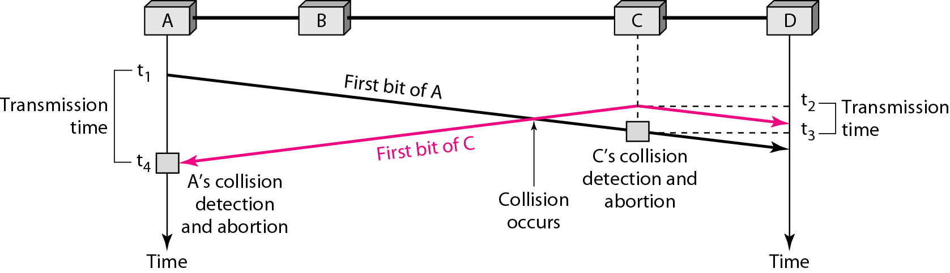
CSMA/CD ...
Look at the first bits transmitted by the two stations involved in the collision
each station continues to send bits in the frame until it detects the collision

Slide 36
CSMA/CD ...
At time t1, station A has executed its persistence procedure and starts sending the bits of its frame
At time t2, station C has not yet sensed the first bit sent by A
Station C executes its persistence procedure and starts sending the bits in its frame, which propagate both to the left and to the right
The collision occurs sometime after time t2
Station C detects a collision at time t3 when it receives the first bit of A’s frame
Station C immediately (or after a short time, but we assume immediately) aborts transmission
Station A detects collision at time t4 when it receives the first bit of C’s frame - immediately aborts transmission
A transmits for the duration t4 − t1; C transmits for the duration t3 − t2

Slide 37
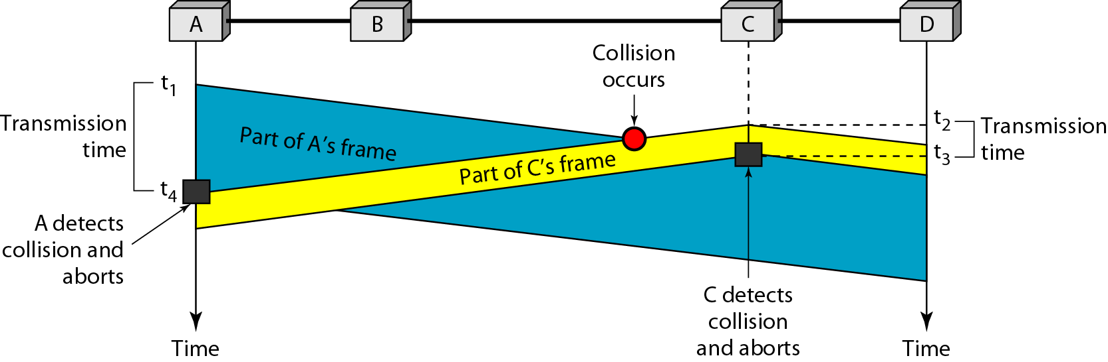
CSMA/CD - Collision and abortion

Slide 38
CSMA/CD -Minimum Frame Size
Need a restriction on the frame size
Before sending the last bit of the frame, the sending station must detect a collision, if any, and abort the transmission
because the station, once the entire frame is sent, does not keep a copy of the frame and does not monitor the line for collision detection
The frame transmission time T_{fr} must be at least two times the maximum propagation time Tp
Worst-case scenario. If the two stations involved in a collision are the maximum distance apart, the signal from the first takes time Tp to reach the second, and the effect of the collision takes another time TP to reach the first
So the requirement is that the first station must still be transmitting after 2Tp

Slide 39
CSMA/CD Example
A network using CSMA/CD has a bandwidth of 10 Mbps
If the maximum propagation time (including the delays in the devices and ignoring the time needed to send a jamming signal is 25.6 μs, what is the minimum size of the frame?
Solution
The minimum frame transmission time is T_{fr} = 2 × Tp = 51.2 μs
The worst case, a station needs to transmit for a period of 51.2 μs to detect the collision
The minimum size of the frame is 10 Mbps × 51.2 μs = 512 bits or 64 bytes
This is actually the minimum size of the frame for Standard Ethernet

Slide 40
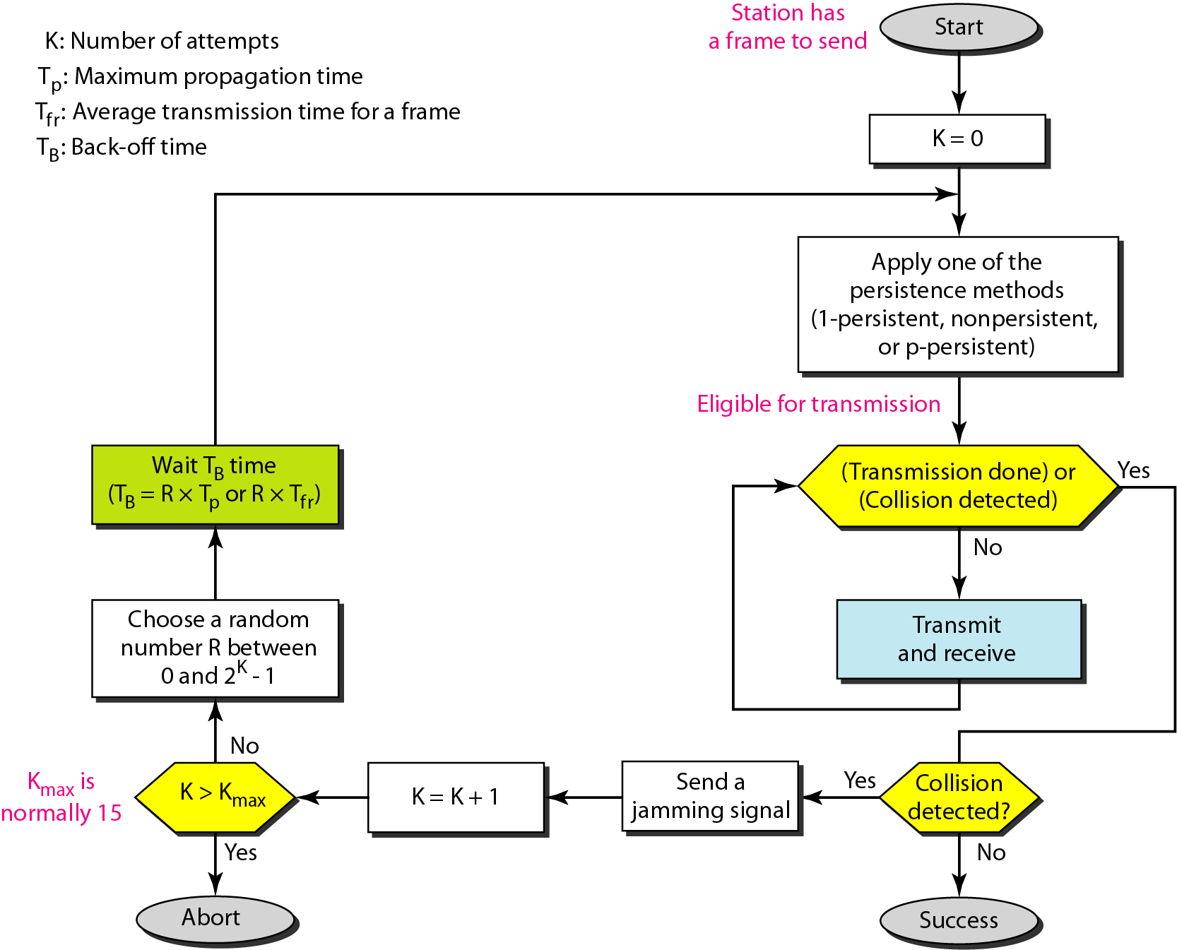
Flow diagram for CSMA/CD

Slide 41
Flow diagram for CSMA/CD
Similar to the one for the ALOHA protocol with 3-differences
addition of the persistence process - sense the channel before start sending the frame by using one of the persistence processes (nonpersistent, 1-persistent, or p-persistent)
frame transmission
In ALOHA, first transmit the entire frame and then wait for an acknowledgment
In CSMA/CD, transmission and collision detection are continuous processes ( shown as a loop)
constantly monitor in order to detect one of two conditions to stop transmission
either transmission is finished or
a collision is detected
On loop exit, if a collision has not been detected, it means that transmission is complete; the entire frame is transmitted. Otherwise, a collision has occurred
Sending of a short jamming signal to make sure that all other stations become aware of the collision

Slide 42
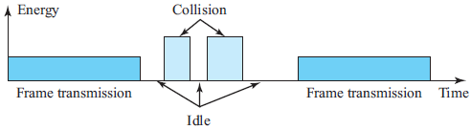
CSMA/CD - Energy Level
The level of energy in a channel can have three values:
Zero - the channel is idle
Normal - station has successfully captured the channel and is sending its frame
Abnormal –there is a collision and the level of the energy is twice the normal level
A station that has a frame to send or is sending a frame needs to monitor the energy level to determine if the channel is idle, busy, or in collision mode

Slide 43
CSMA/CD - Throughput
greater than that of pure or slotted ALOHA
The maximum throughput occurs at a different value of G and is based on the persistence method and the value of p in the p-persistent approach
For the 1-persistent method, the maximum throughput is around 50 percent when G = 1
For the nonpersistent method, the maximum throughput can go up to 90 percent when G is between 3 and 8
Traditional Ethernet is a broadcast LAN that used the 1-persistence method to control access to the common media with the data rate of 10 Mbps

Slide 44
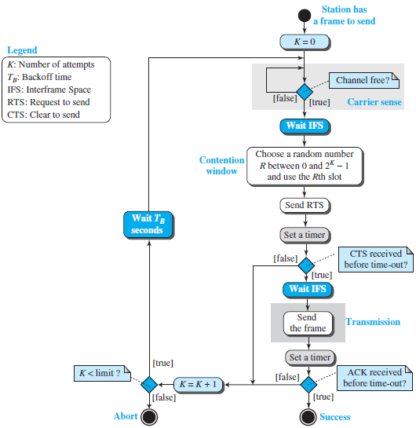
Carrier sense multiple access with collision avoidance - CSMA/CA
Invented for wireless networks
Collisions are avoided through the use of CSMA/CA’s three strategies:
the interframe space
the contention window
acknowledgments

Slide 45
CSMA/CA- Interframe Space (IFS)
Avoids collisions by deferring transmission even if the channel is found idle
When an idle channel is found, the station waits for a period of IFS time
IFS time allows the front of the transmitted signal by the distant station to reach this station
After waiting an IFS time, if the channel is still idle, the station can send, but it still needs to wait a time equal to the contention window
The IFS variable can also be used to prioritize stations or frame types
For example, a station that is assigned a shorter IFS has a higher priority

Slide 46
CSMA/CA - Contention Window
An amount of time divided into slots
A station that is ready to send chooses a random number of slots as its wait time
The number of slots in the window changes according to the binary exponential backoff strategy
It is set to one slot the first time and then doubles each time the station cannot detect an idle channel after the IFS time
Very similar to the p-persistent method except that a random outcome defines the number of slots taken by the waiting station
The station needs to sense the channel after each time slot
However, if the station finds the channel busy, it does not restart the process; it just stops the timer and restarts it when the channel is sensed as idle
This gives priority to the station with the longest waiting time

Slide 47
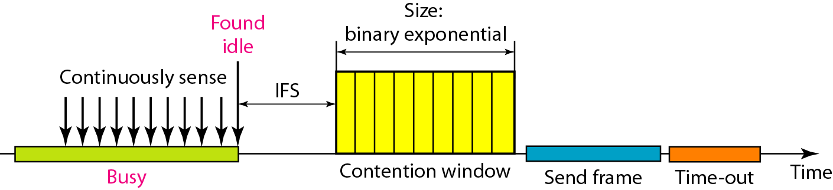
CSMA/CA - Timing

Slide 48
CSMA/CA - Acknowledgment
With all these precautions, there still may be a collision resulting in destroyed data
In addition, the data may be corrupted during the transmission
The positive acknowledgment and the time-out timer can help guarantee that the receiver has received the frame

Slide 49
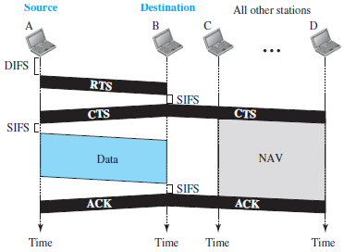
CSMA/CA -Frame Exchange Time Line

Slide 50
CSMA/CA -Frame Exchange Time Line
Exchange of data and control frames in time.
1. Before sending a frame, the source station senses the medium by checking the energy level at the carrier frequency
a. The channel uses a persistence strategy with backoff until the channel is idle
b. After the station is found to be idle, the station waits for a period of time called the DCF interframe space (DIFS); then the station sends a control frame called the request to send (RTS).
2. After receiving the RTS and waiting a period of time called the short interframe space (SIFS), the destination station sends a control frame, called the clear to send (CTS), to the source station. This control frame indicates that the destination station is ready to receive data.
3. The source station sends data after waiting an amount of time equal to SIFS.
4. The destination station, after waiting an amount of time equal to SIFS, sends an acknowledgment to show that the frame has been received. Acknowledgment is needed in this protocol because the station does not have any means to check for the successful arrival of its data at the destination. On the other hand, the lack of collision is a kind of indication to the source that data have arrived.

Slide 51
CSMA/CA - Network Allocation Vector
How do other stations defer sending their data if one station acquires access?
how is the collision avoidance aspect of this protocol accomplished?
Use key feature Network Allocation Vector (NAV):
When a station sends an RTS frame, it includes the duration of time that it needs to occupy the channel
The stations that are affected by this transmission create a timer called a network allocation vector (NAV) that shows how much time must pass before these stations are allowed to check the channel for idleness
Each time a station accesses the system and sends an RTS frame, other stations start their NAV

Slide 52
CSMA/CA -Collision During Handshaking
handshaking period - time when RTS or CTS control frames are in transition
What happens if there is a collision during handshaking period ?
Indicates two or more stations may try to send RTS frames at the same time which may collides
No mechanism for collision detection, the sender assumes there has been a collision if it has not received a CTS frame from the receiver
The backoff strategy is employed, and the sender tries again

Slide 53
CSMA/CA - Hidden-Station Problem
Use of the handshake frames (RTS and CTS)
The RTS message from B reaches A, but not C.
However, because both B and C are within the range of A, the CTS message, which contains the duration of data transmission from B to A, reaches C
Station C knows that some hidden station is using the channel and refrains from transmitting until that duration is over

